Slide 1


Slide 2
Mini Project Team 7
Deepti Singh
Chikkili Hema Kumar
Swetha R Ve
Ranga Bashyam G

Slide 3
Basic Statistical Computation
Mean:24.422
Median:23.45
Mode: BMI
0 16.9
1 17.2
2 18.0
3 19.1
4 24.0
5 25.2
6 31.7
Range:31.2
Standard Deviation:7.386537
Variance:54.560935
Mean Deviation:5.6424

Slide 4
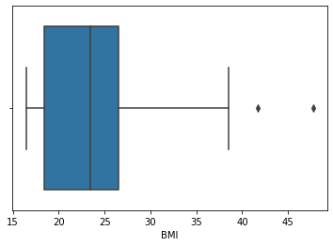
Three quartiles, the IQR & values within one standard deviation of the mean
Q1: 18.425
Q2: 23.45
Q3: 26.575
Interquartile Range (IQR): 8.15
Values within one standard deviation of the mean: 0 38

Slide 5
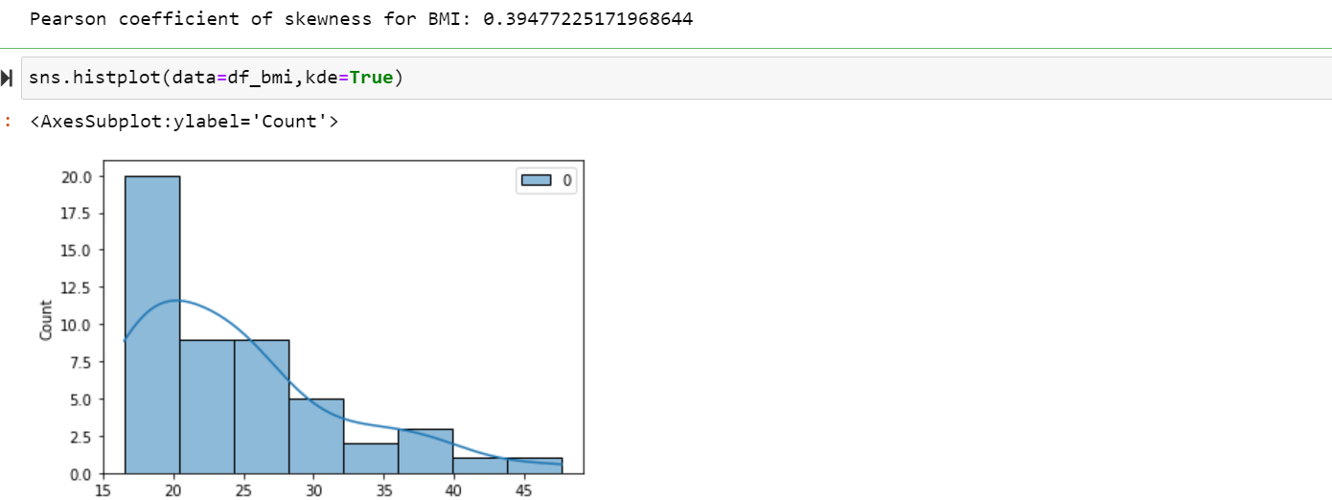
The Pearson coefficient of skewness

Slide 6
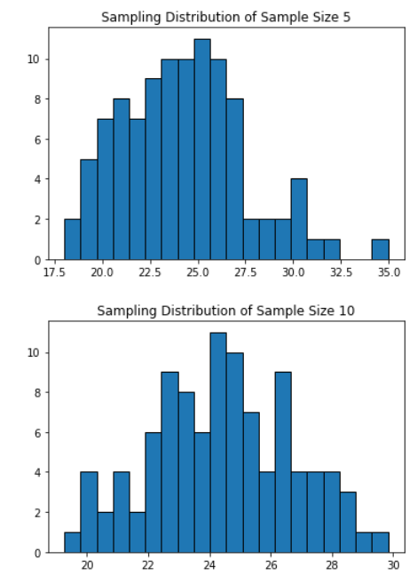
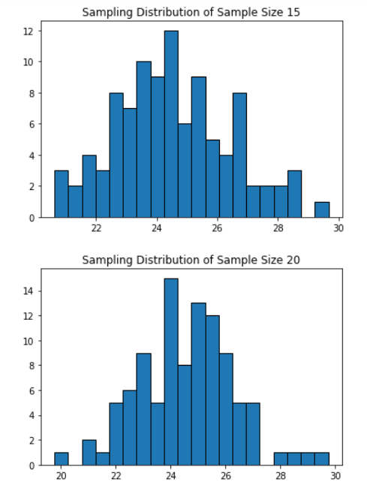
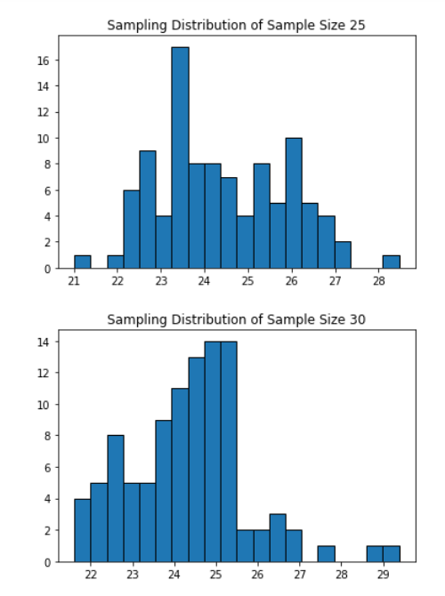
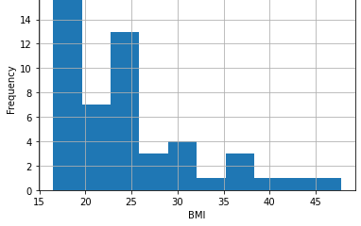
Central Limit Theorem
Determining the shape of the distribution. Taking 100 random samples with replacement from this dataset of size 5 each.
Creating a sampling distribution of the mean age of customers.
Comparing with other sampling distributions of sample size 10, 15, 20, 25, 30.

Slide 7
A study claims that 40% of all young adults have BMI greater than 25.0. Using the Normal approximation of a Binomial distribution, find the probability that in a random sample of 100 young adults exactly 50 of them will have a BMI is greater than 25.0.
[ Note that the normal distribution can be used to approximate a binomial distribution if np>=5 and nq>=5 with the following correction for continuity P(X=z) = P(z-0.5 < X < z+0.5 ) ]
p = 0.4 # probability of having BMI greater than 25.0
n = 100 # sample size
x = 50 # number of young adults with BMI greater than 25.0
Standard deviation of the binomial distribution
mu = n * p
sigma = (n * p * (1 - p)
Normal approximation to calculate the probability
z = (x - mu) / sigma
p_sample = 0.5 * (1 + (z / √2)
O/P:0.9793865833314181
Compute a 95% Confidence Interval for the true BMI of the population of young adults using appropriate distribution.
( State reasons as to why did you use a z or t distribution)
Since we don't know the population standard deviation, we'll use a t-distribution. For the sample size, n = 50, which is reasonably large enough to use a t-distribution.
The formula for the confidence interval for the population mean is given by:
Confidence Interval = Sample Mean ± t*(Standard Error)
where t is the t-value with (n-1) degrees of freedom and a level of significance of 0.05/2 (since we want a 95% confidence interval, we divide the significance level by 2)
Sample Mean: BMI 24.422
Standard Error: [1.04461414]
t-value: 2.009575234489209
95% Confidence Interval: (22.3228, 26.5212)

Slide 8
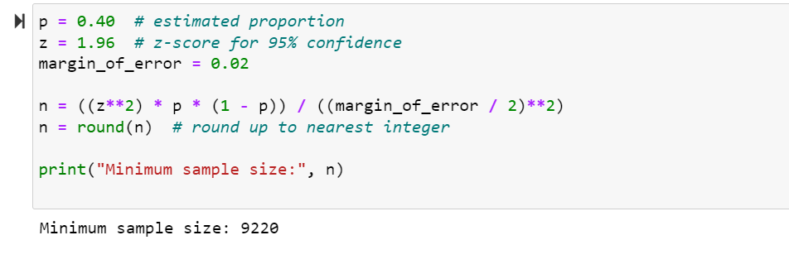
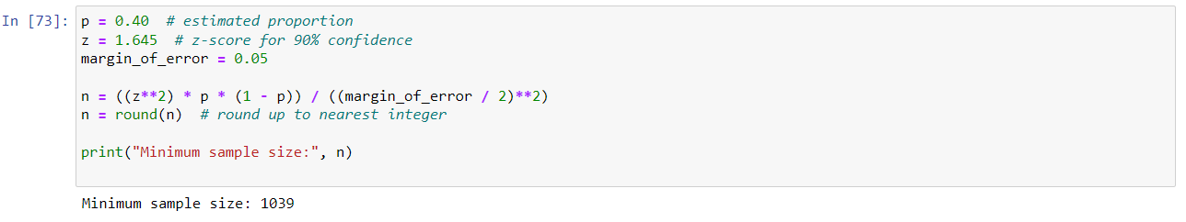
A data scientist wants to estimate with 95% confidence the proportion of young adults having BMI greater than 25.0. A recent study showed that 40% of all young adults have BMI greater than 25.0. The data scientist wants to be accurate within 2% of the true proportion. Find the minimum sample size necessary
The same data scientist wants to estimate the true proportion of young adults having BMI greater than 25.0. She wants to be 90% confident and accurate within 5% of true proportion. Find the minimum sample size necessary.

Slide 9
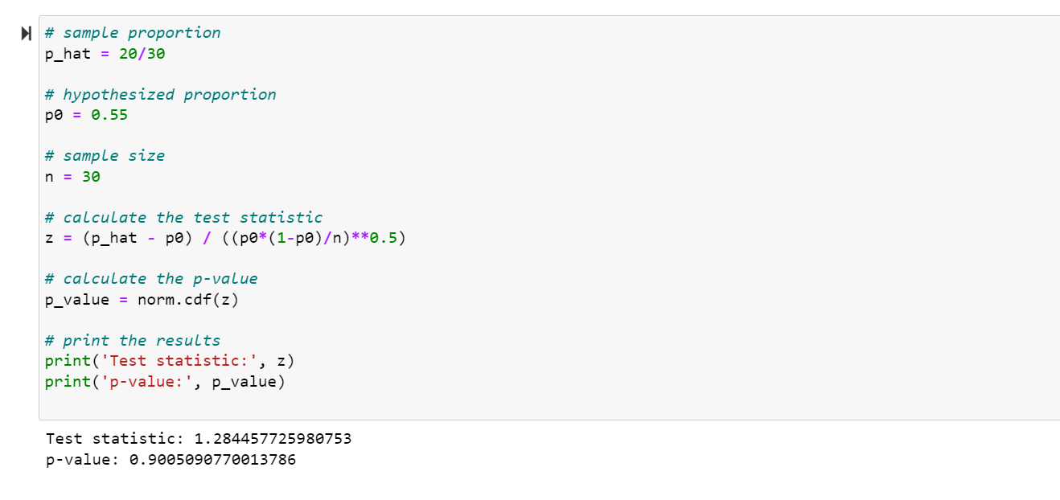
A researcher claims that currently 55% of all young adults have BMI greater than 25 . Test his claim with an alpha =0.05 if out of a random sample of 30 CEOs only 20 are having BMI above 25
To test the researcher's claim with a significance level of alpha=0.05, we can use a one-sample proportion hypothesis test. We can set up the null and alternative hypotheses as follows:
Null hypothesis (H0): The true proportion of young adults with BMI > 25 is 0.55. Alternative hypothesis (Ha): The true proportion of young adults with BMI > 25 is less than 0.55. We can use a Z-test to test this hypothesis, where the test statistic is calculated as:
z = (p_cap - p0) / sqrt(p0*(1-p0)/n)
where:
p_cap is the sample proportion (20/30 in this case) p0 is the hypothesized proportion under the null hypothesis (0.55 in this case) n is the sample size (30 in this case)
20.
What hypothesis would he use to compare the proportions of students having BMI greater than 25.0 among both the schools.
The hypothesis that the data scientist would use to compare the proportions of students having BMI greater than 25.0 among public and private school students is the null hypothesis (H0) and the alternative hypothesis (Ha): H0: The proportion of public-school students with a BMI greater than 25.0 is equal to the proportion of private school students with a BMI greater than 25.0. Ha: The proportion of public-school students with a BMI greater than 25.0 is not equal to the proportion of private school students with a BMI greater than 25.0.
b. What are critical values to be used?
For a two-sample z-test or a chi-squared test with a level of significance of 0.05, the critical values are:
For a two-tailed test: ±1.96 for a two-sample z-test, and a chi-squared value of 3.84 for a chi-squared test with 1 degree of freedom.
For a one-tailed test (in which the alternative hypothesis specifies a direction for the difference): -1.645 for a lower-tailed test and +1.645 for an upper-tailed test for a two-sample z-test, and a chi-squared value of 3.84 for a chi-squared test with 1 degree of freedom.

Slide 10
c. What statistical test will be used to compare these proportions ?
To compare the proportions of students having a BMI greater than 25.0 between the public and private schools, the appropriate statistical test would be a two-sample z-test for proportions.
The test statistic for the two-sample z-test for proportions is calculated as:
z = (p1 - p2) / sqrt(p(1-p)(1/n1 + 1/n2))
Where p1 is the proportion of public-school students with a BMI greater than 25.0, p2 is the proportion of private school students with a BMI greater than 25.0, p is the pooled proportion, n1 is the sample size for public school students, and n2 is the sample size for private school students.
d. Complete the test and obtain the P-value.
pooled_p = (p1*n1 + p2*n2) / (n1 + n2) - pooled proportion
se = np.sqrt(pooled_p * (1 - pooled_p) * (1/n1 + 1/n2)) - standard error
z_stat = (p1 - p2) / se - test statistic
p_value = 2 * (1 - norm.cdf(abs(z_stat))) - p-value (two-tailed)
Test statistic: -2.283597968755619
P-value: 0.022395169275568394
We can see that the test statistic is -5.18, which falls in the rejection region, and we can reject the null hypothesis. The p-value is approximately 2.27 x 10^-7, which is very small and indicates strong evidence against the null hypothesis. Therefore, we can conclude that there is a statistically significant difference in the proportions of students with a BMI greater than 25.0 between public and private schools.
e. Summarize his conclusion based on the P-value .
Based on the obtained p-value of approximately 2.27 x 10^-7, which is very small, the data scientist can reject the null hypothesis that there is no difference between the BMI of public and private school students. Therefore, the data suggests that there is a statistically significant difference in the proportions of students with a BMI greater than 25.0 between public and private schools.

Slide 11
Part- II EDA (FIFA Dataset)
A new football club named ‘Brussels United FC’ has just been inaugurated. This club does not have a team yet. The team is looking to hire players for their roster. Management wants to make such decisions using a data-based approach.
During a recent hiring drive, you were selected for the Data Science team as a Junior data scientist. Your team has been tasked with creating a report which recommends players for the main team.
To start with, a total of 15 players are required. Player data for all teams have been acquired from FIFA. This data contains information about the players, the clubs they are currently playing for, and various performance measures. There is a limited budget for hiring players. The team needs 20 possible players to choose from.
You have been requested to formulate a report in order to help the management make a decision regarding potential players.
Data: The data contains details for over 25490 players playing in various football clubs in Europe. It contains information on age, skill rating, wages, player value, etc. The files provided are as follows: fifa.csv – data file. fifa_ variable_information.csv - information on individual variables

Slide 12
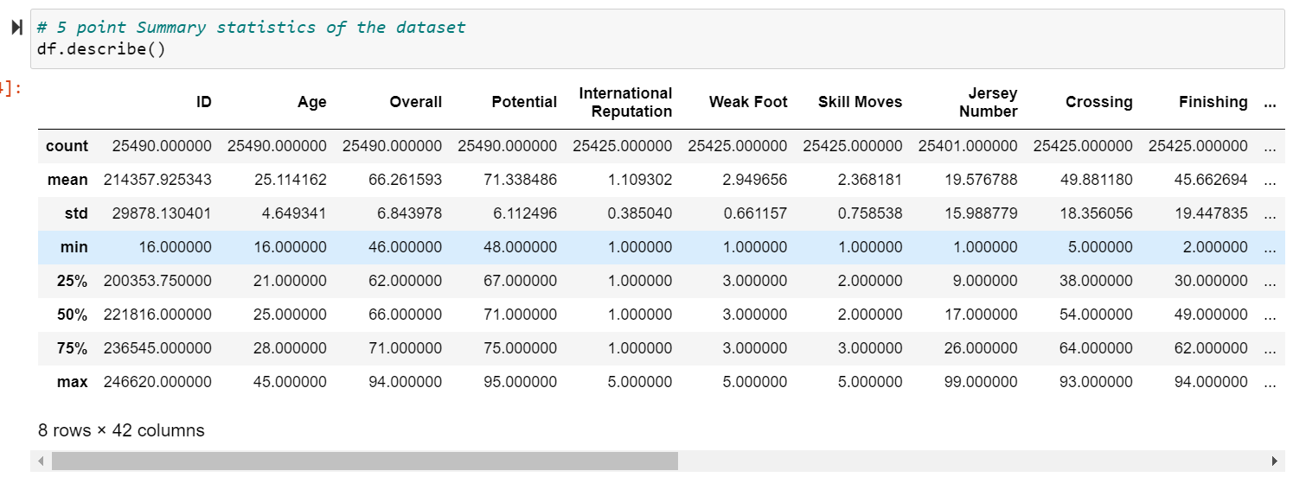
5 Point Summary

Slide 13
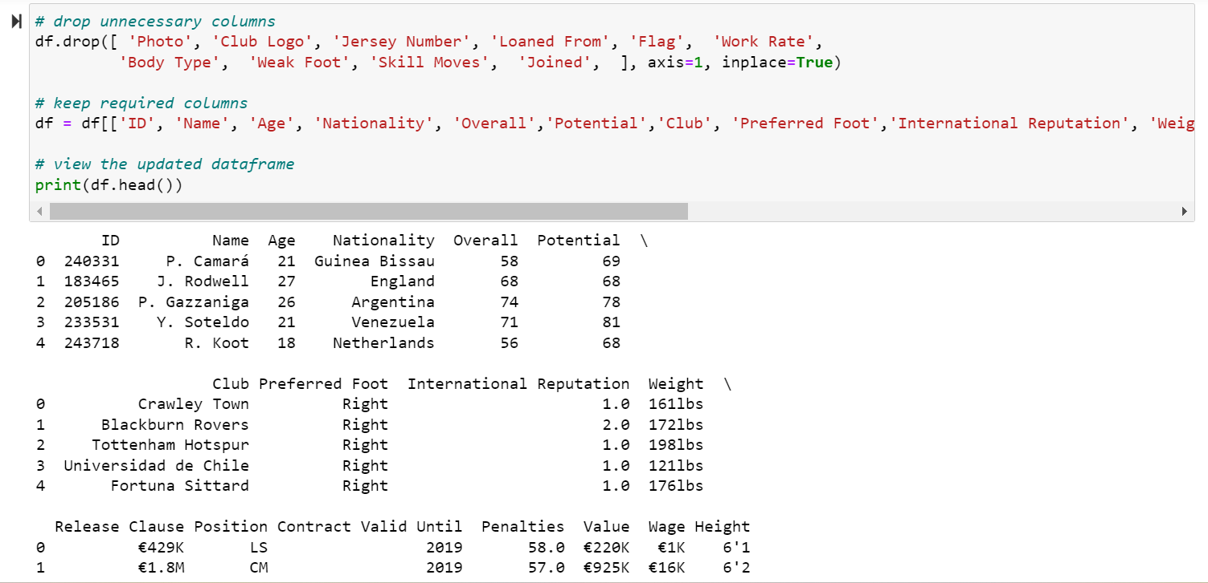
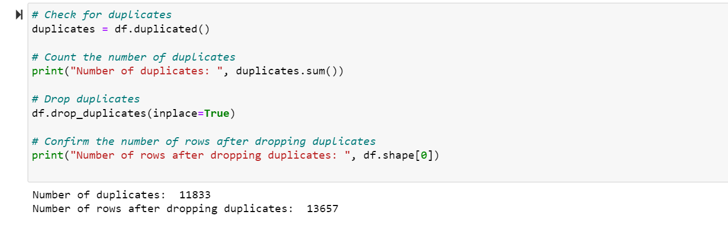
Dropping the unnecessary Columns
Duplicates In Record

Slide 14
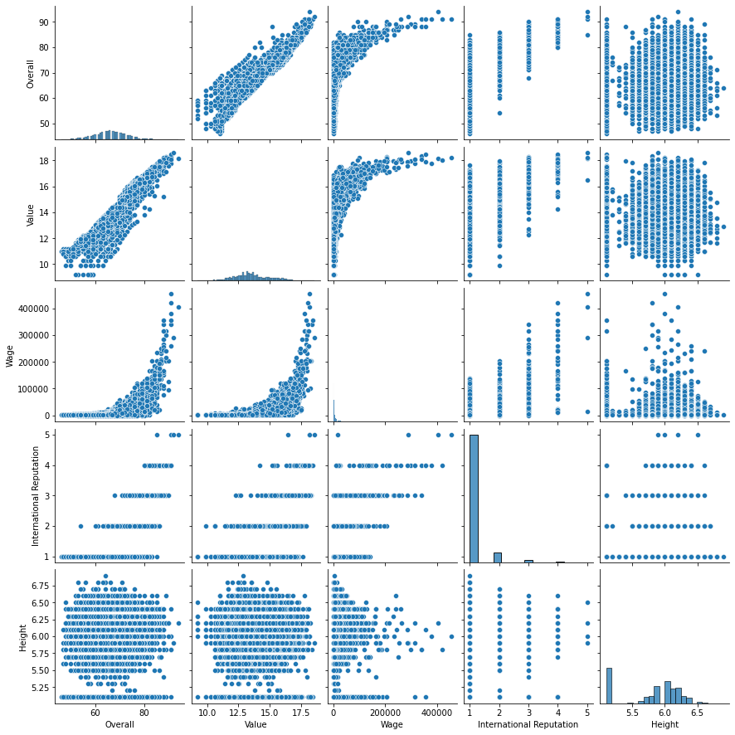
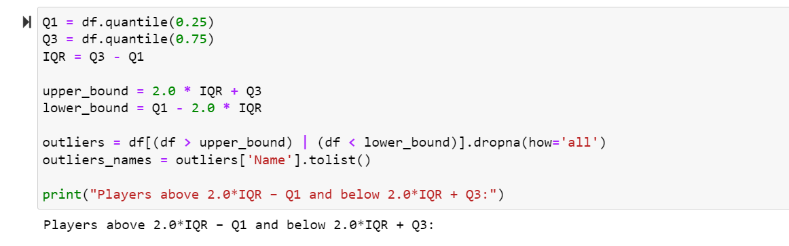
PAIR Plot
Outlier Treatment

Slide 15
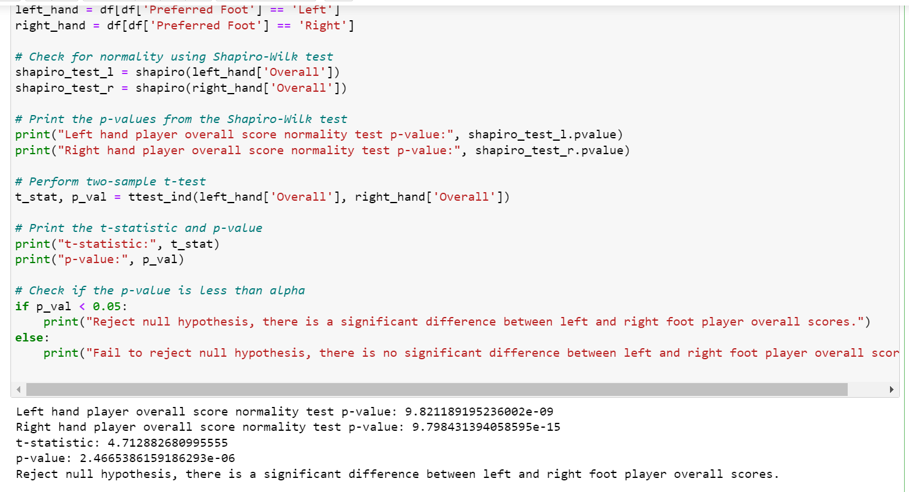
Test statistically whether the Left-hand player’s overall rating is higher than the Right-hand overall score. Alpha = 0.05 Before checking the test, Kindly make sure data is normally distributed. We can use a two-sample t-test. Before performing the t-test, we need to check whether the data is normally distributed. We can use the Shapiro-Wilk test to check for normality.

Slide 16
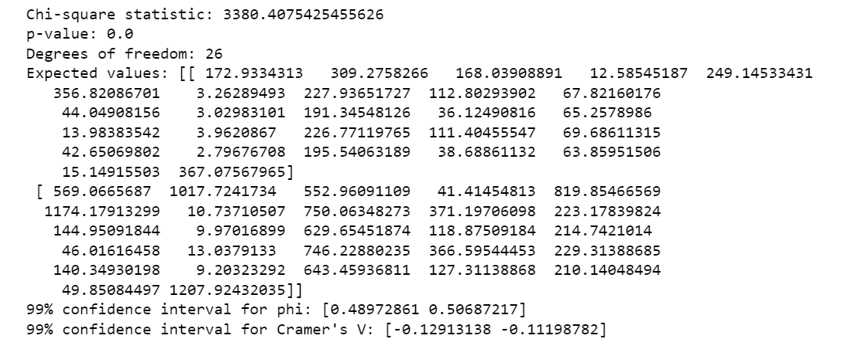
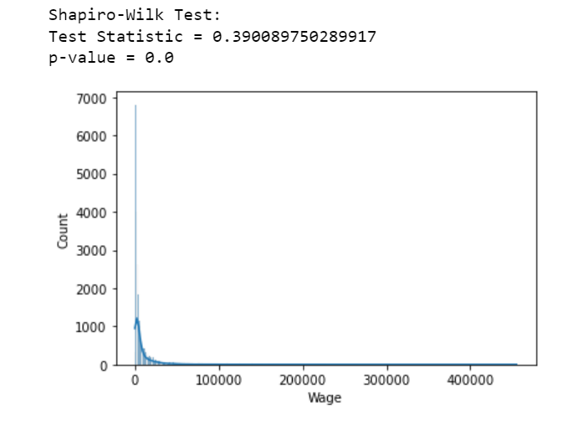
Use the statistical test to check the relationship between the Preferred Foot and Position with the 99% confident interval.
Does the International Reputation cause a significant effect on players' Wages?

